Slide 1

Benchmarking architecture performance through computer vision
By Ethan Le, Lyndon Lam, Virgil Nhieu, Angie Sy Group I

Slide 2
Content
Background
Recap on YOLO
Benchmarking Process
Benchmarking Materials
Benchmarking Results
Concluding Remarks
Further Improvements
Testing YOLO on Aircraft Carriers
Accuracy Over Multiple Runs

Slide 3
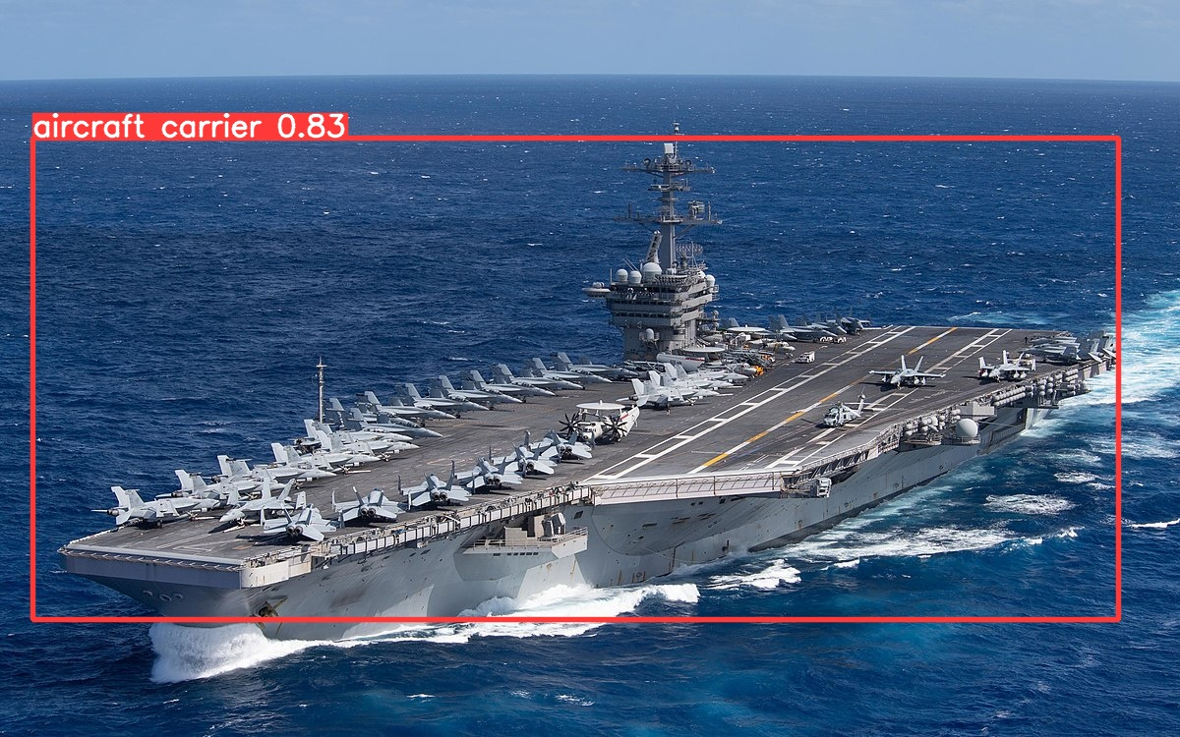
Background
Benchmarking Purpose
Benchmarking computer architecture involves evaluating and comparing different systems to understand how well they perform specific tasks such as gaming or image recognition.
Key Components Tested
Standardized tests are conducted on components like processors, memory, and graphics to assess their speed, efficiency, and overall capabilities.
Significance
The significance of benchmarking lies in aiding informed decisions about choosing systems tailored to specific tasks, ensuring optimal performance and value for computing needs.
Project Focus
Our project centers on benchmarking computer architecture performance through computer vision, specifically by training multiple CPUs and even GPUs through YOLO to recognize aircraft carriers in pictures.

Slide 4
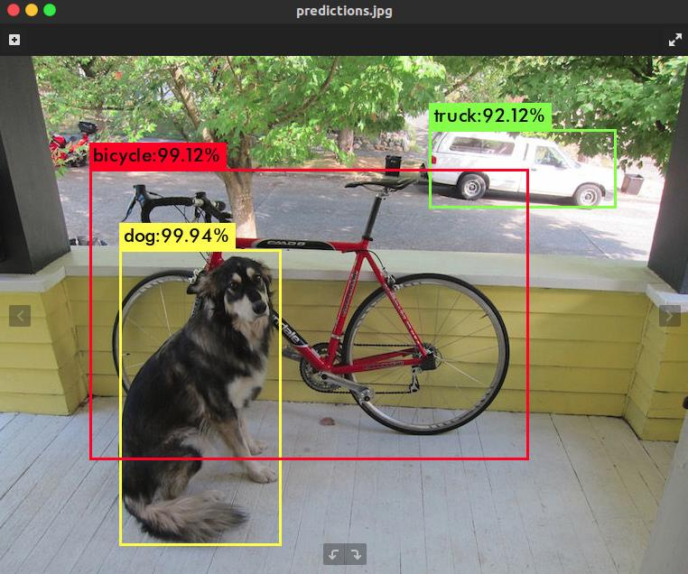

Recap on Yolo
YOLO (You Only Look Once) is a real-time object detection system, designed to quickly and accurately identify objects within images or video frames.

Slide 5
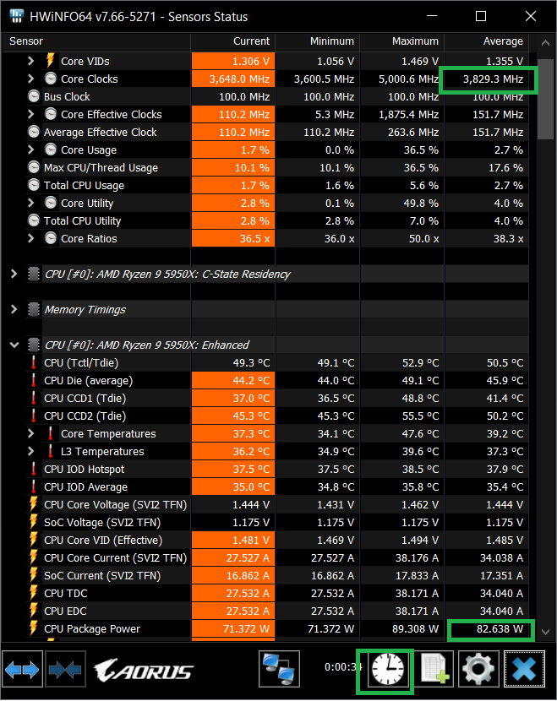
Benchmarking Process
The time of each epoch was recorded in the YOLO training program a total of 10 times
To record the CPU wattage and CPU frequency for the Windows systems, we used HWiNFO
For the Linux systems, we used turbostat, lm-sensors, and inxi to measure the CPU wattage and CPU frequency

Slide 6
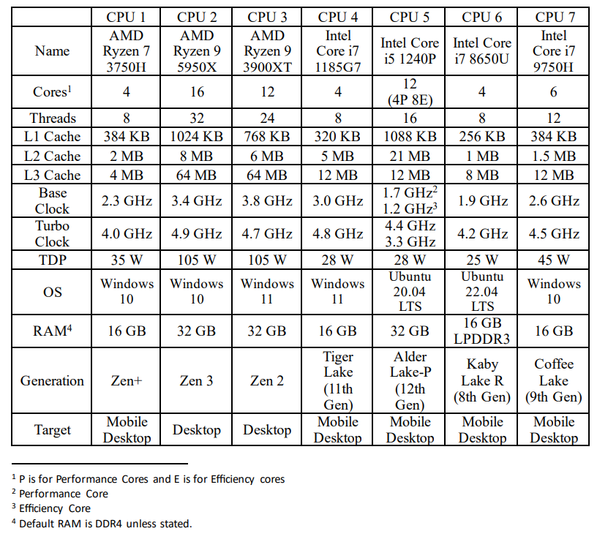
Benchmarking Materials
The table shows the CPUs used to run and benchmark using our process stated previously.
Includes the number of cores, threads, amount of cache for all levels, clock speeds, thermal design power, the operating system the CPU is running in, amount of RAM, the generation architecture, and the target platform for the CPU.

Slide 7
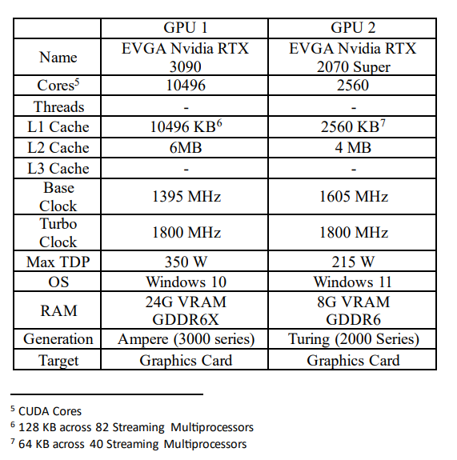
Bonus: One Two more
Added two GPUs to compare with our CPUs
EVGA FTW3 ULTRA RTX 3090
EVGA XC ULTRA RTX 2070 Super

Slide 8
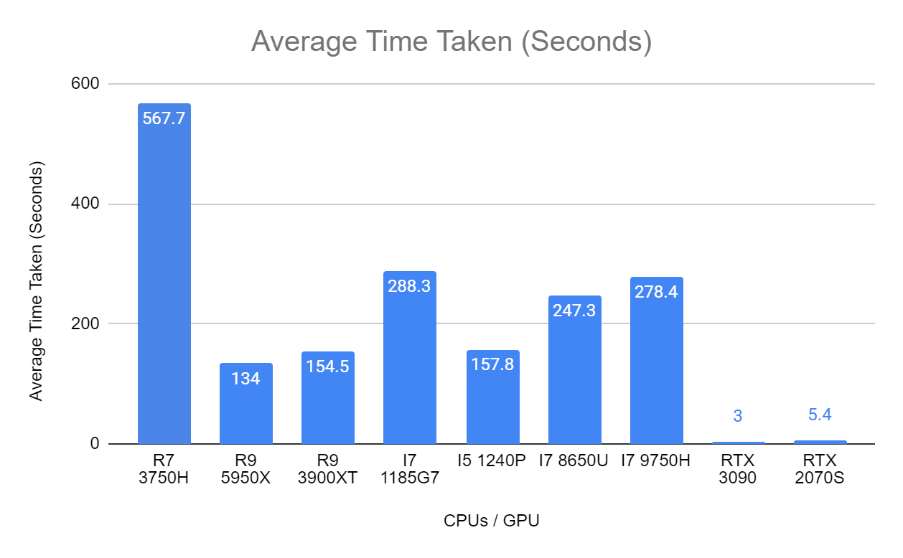
Benchmarking results
Out of the CPUs, the Ryzen 9 5950X is the fastest at a little over 2 minutes.
The I5 1240P has similar performance to the desktop Ryzen 9 3900XT
GPUs smashed the competition

Slide 9
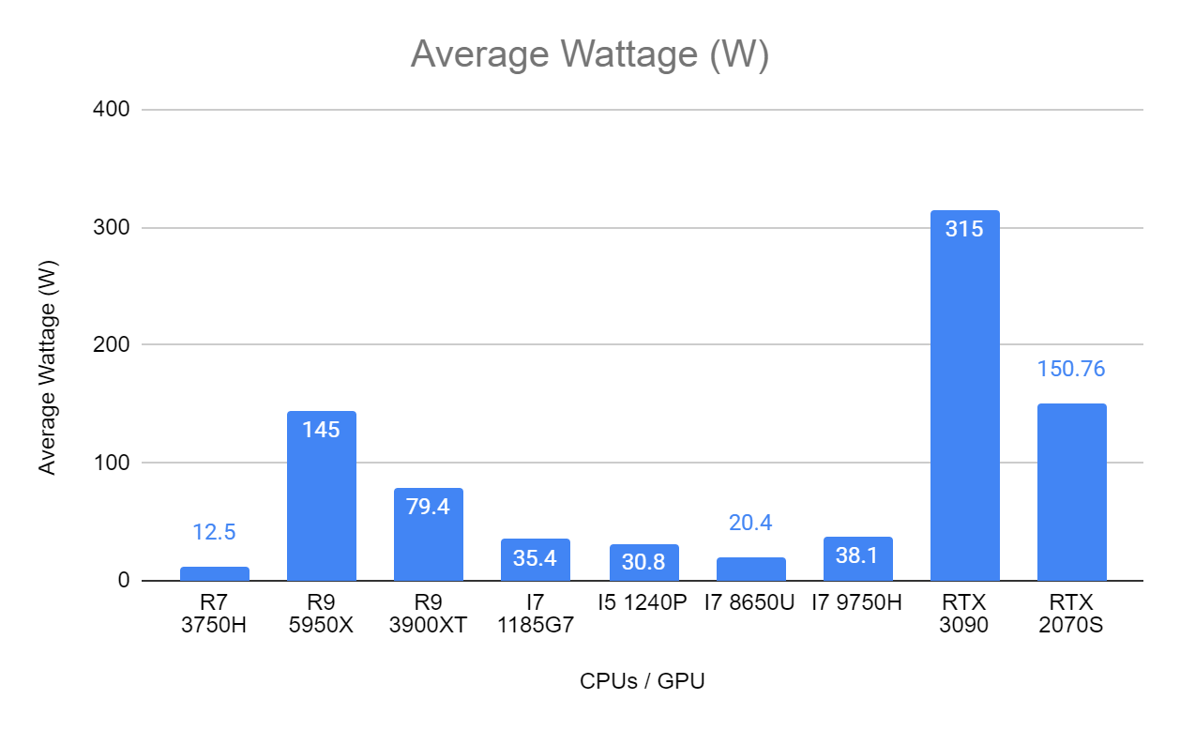
Benchmarking results
The Ryzen 7 3750H, although being the slowest, consumes the least amount of power.
I5 1240P showed similar performance with half the power draw of the 3900XT.
The RTX 3090 consumes the most power while finishing training the quickest.

Slide 10
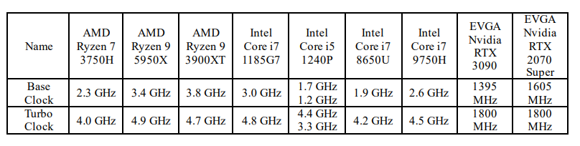
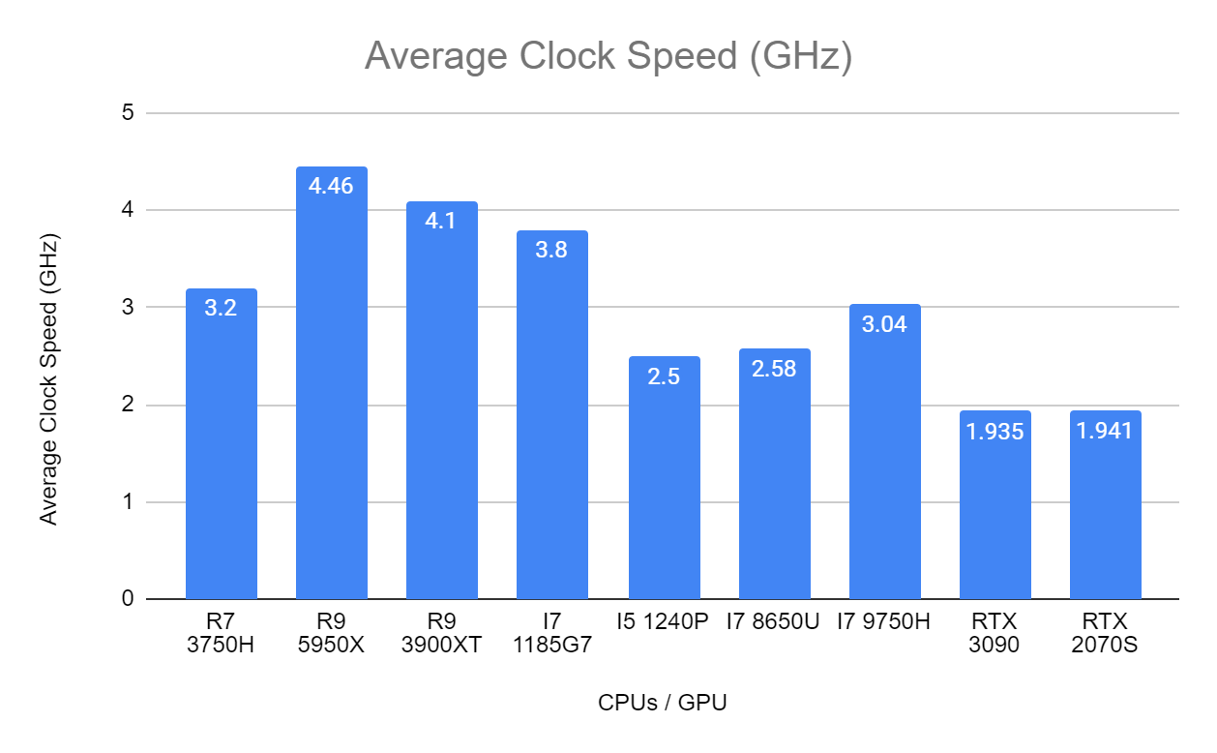
Benchmarking results
All CPUs could not hold their factory rated turbo clock.
Turbo clocks are misleading, ex. The Ryzen 9 5950X can reach 4.9 GHz, but only on one core for a short burst.
GPUs read a higher clock than factory specification with factory settings.

Slide 11
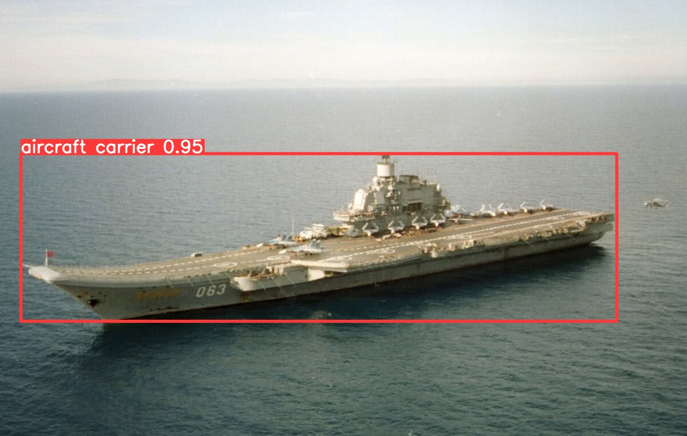
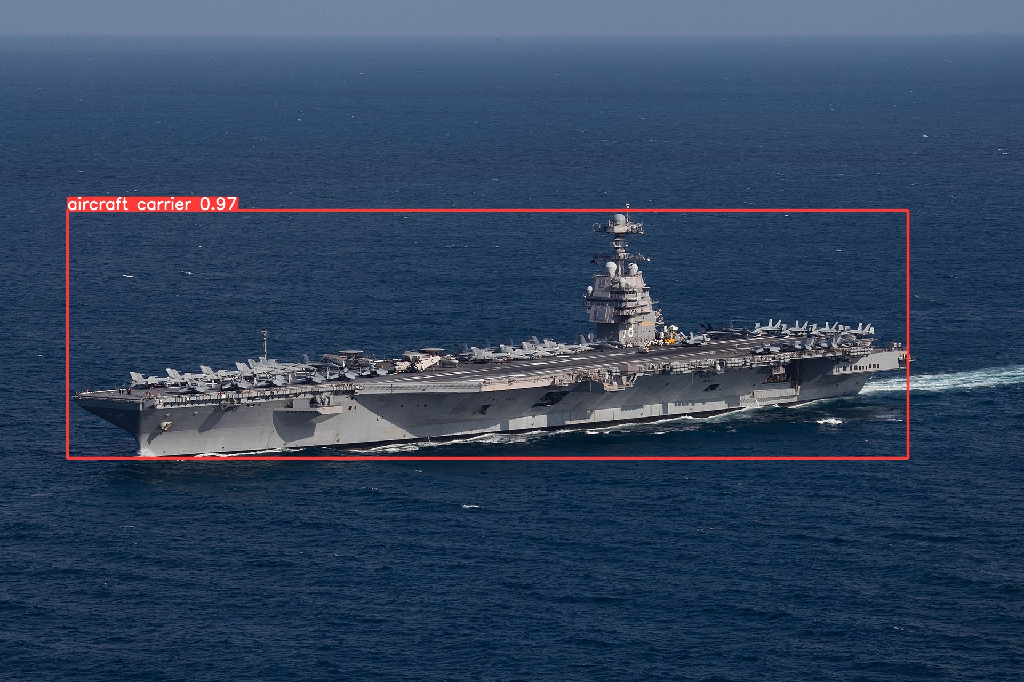
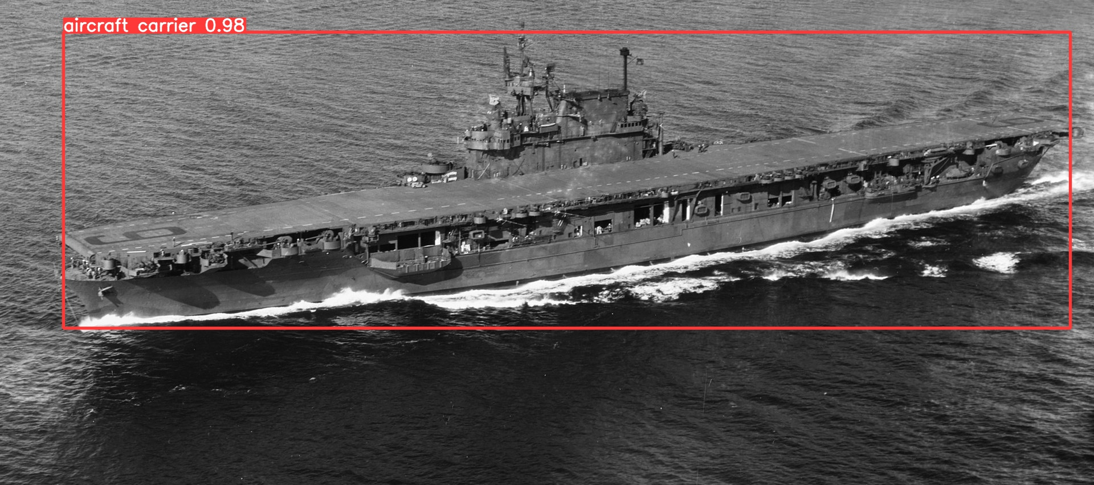
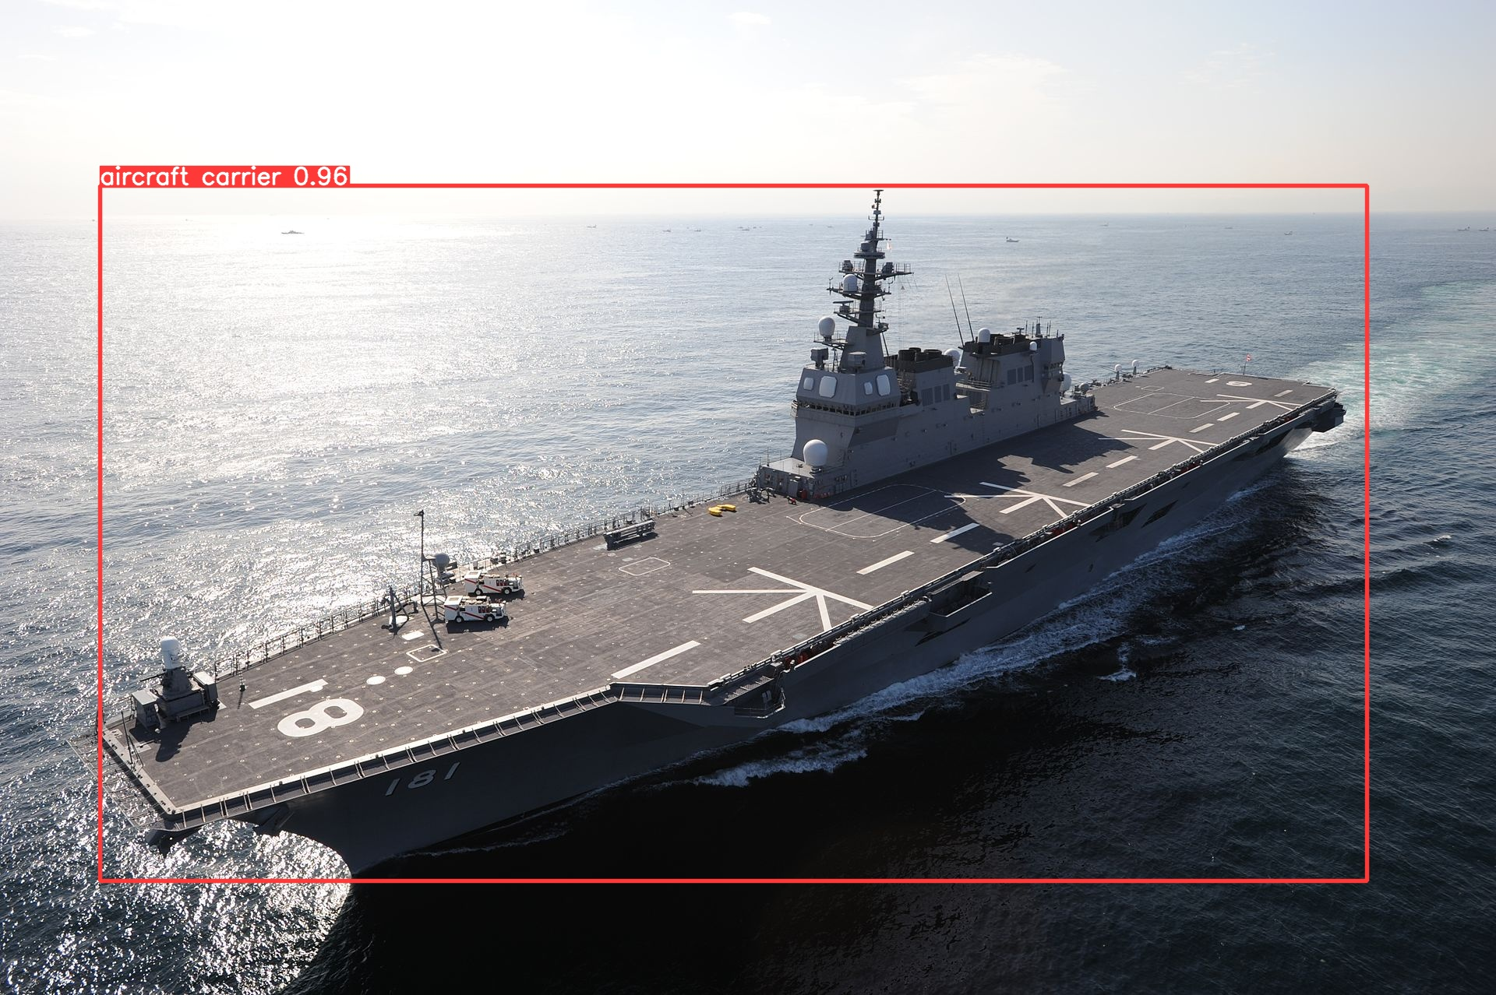
Testing Yolo on aircraft carriers

Slide 12
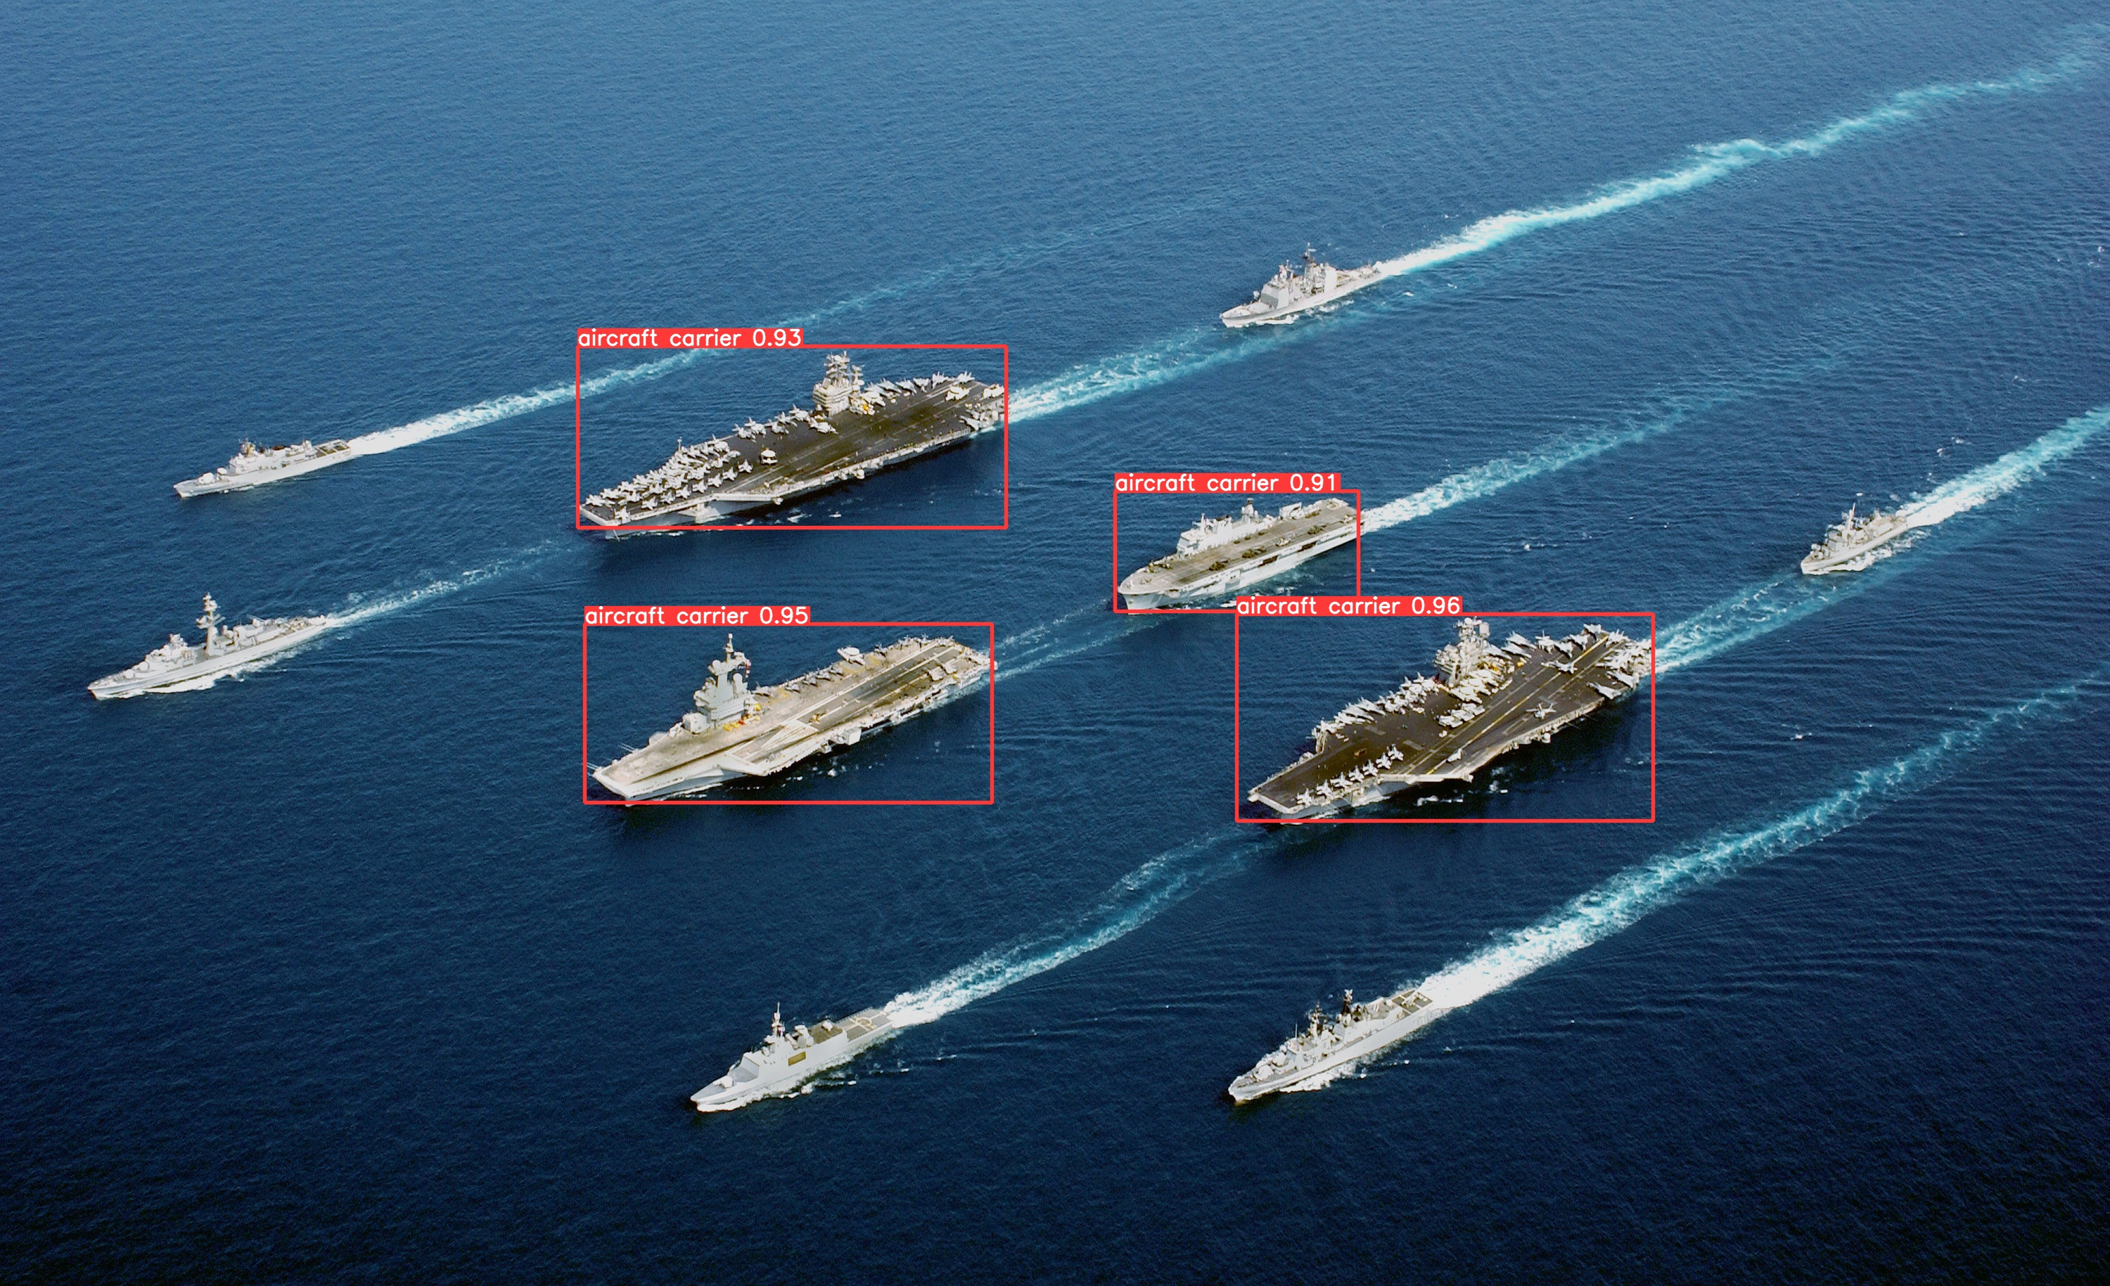
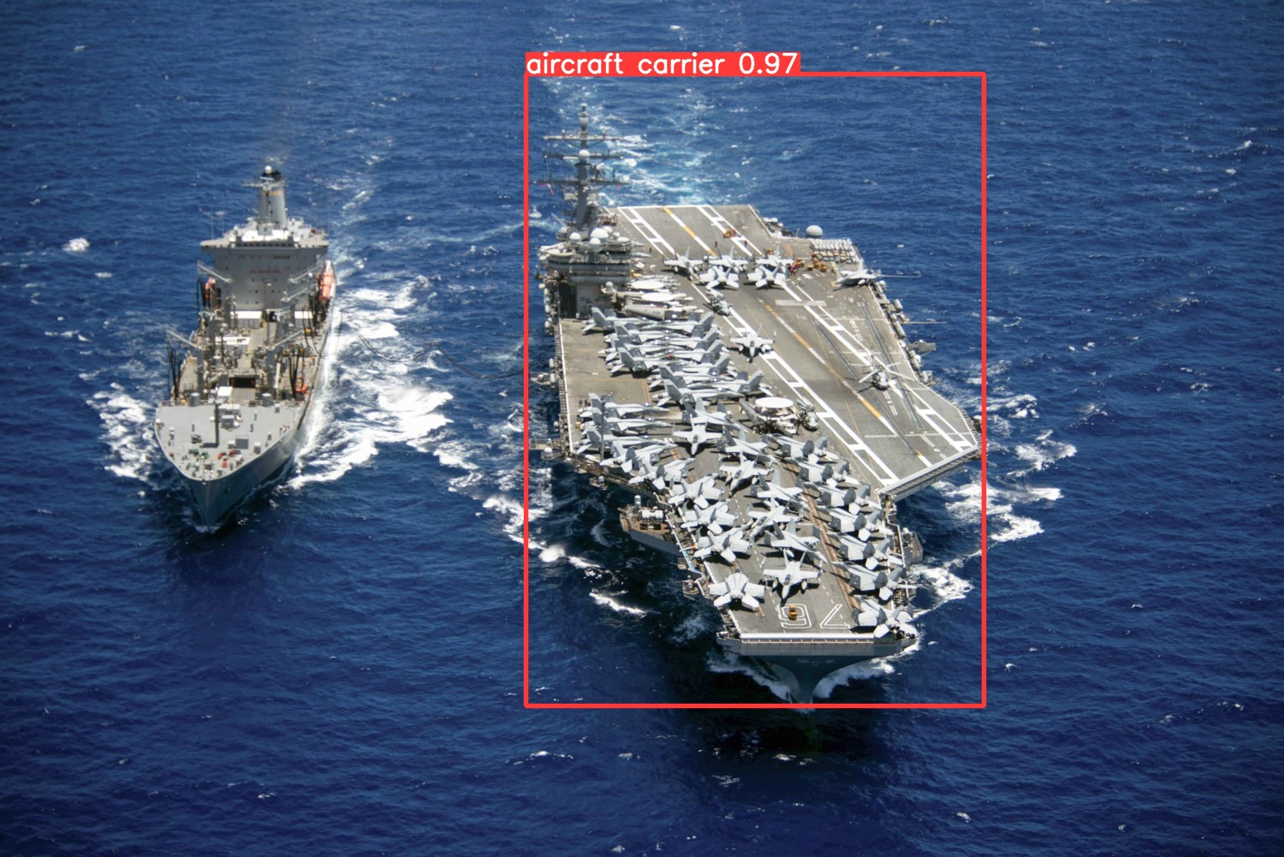
Different Angles
Far Away + Clustered
Head On

Slide 13
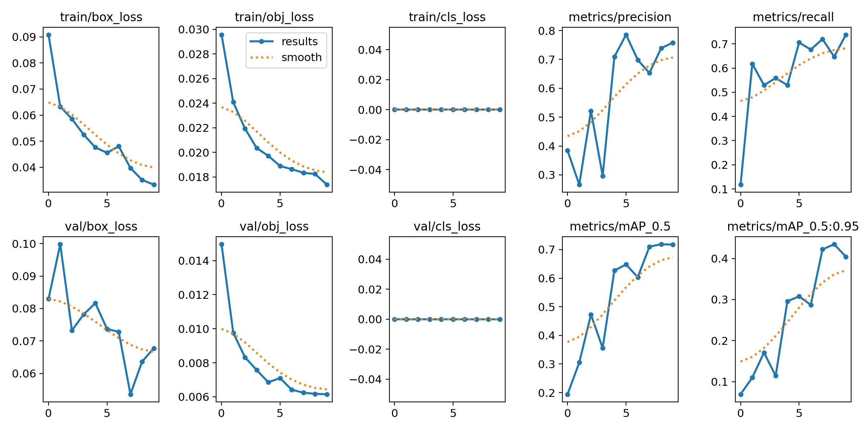
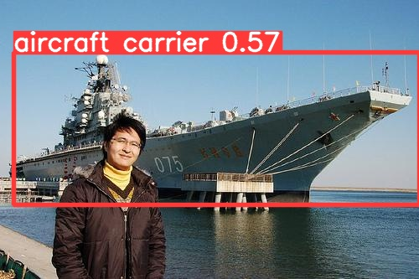
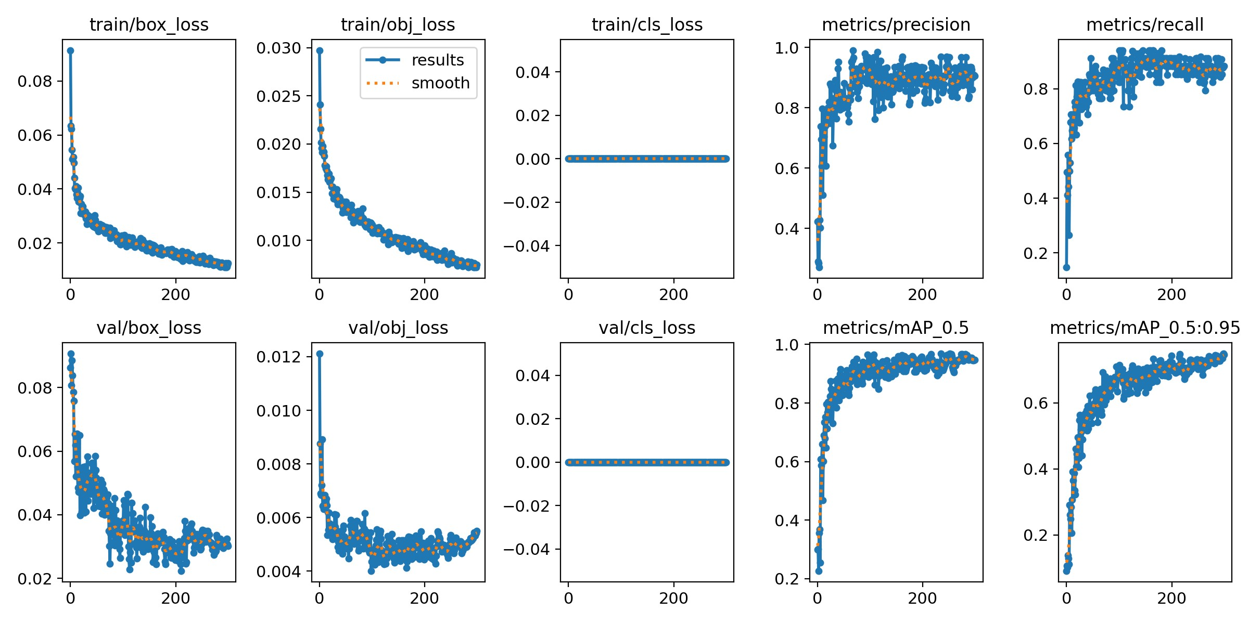
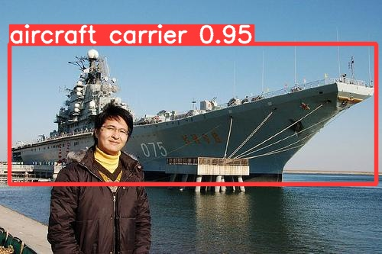
Accuracy over multiple runs
10 Epochs Model
300 Epochs Model

Slide 14
Concluding Remarks
With every epoch that we train, the more accurate the model will be up to a point where accuracy does not improve
Too little epochs means that the model will not be accurate.
The CPU to choose is the Ryzen 9 5950X based on its raw performance per epoch.
The I5 1240P is best performance per watt choice
Ryzen 7 3750H would be the best choice for resource constrained environments.

Slide 15
Further improvements
Future benchmarking accuracy can be further improved if all the CPUs used the same type of RAM as well as the same amount of RAM.
1
Include reading the temperatures of the CPUs while benchmarking, some CPUs may be thermally limited compared to others that are liquid cooled.
2
Add more epochs to get more accurate data for measuring the speed of each epoch completed.
3
Try benchmarks on a Windows OS and Linux OS on the same CPU to determine if operating system plays a role in how effective the model training is.
4

